Slide 1
Unit 2 : Error Control Coding Techniques
Linear block codes – Hamming codes
Prepared by
G.Balamurugan
Assistant Professor, MIT

Slide 2





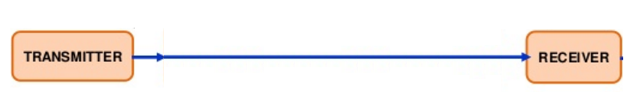
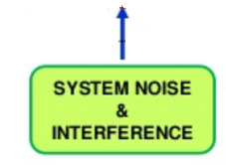
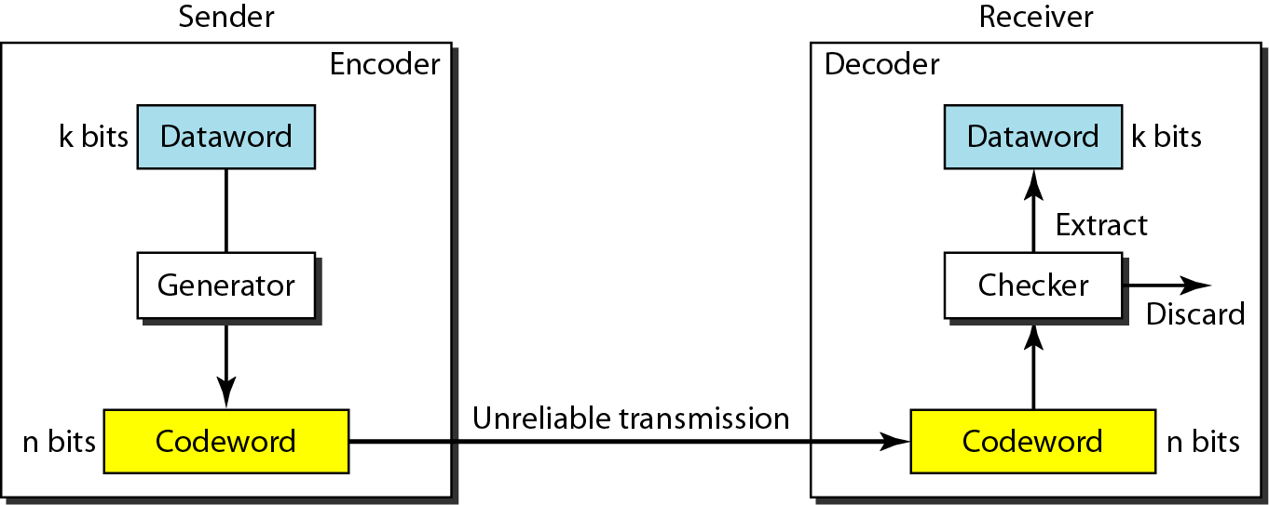
Introduction

Slide 3
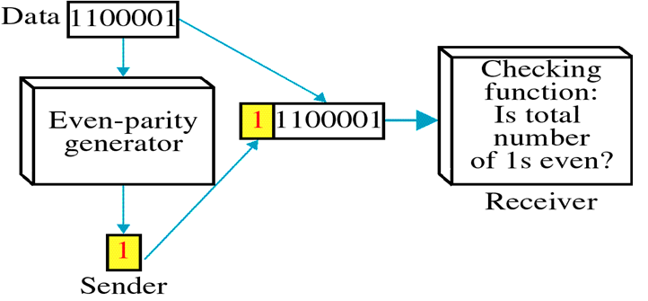
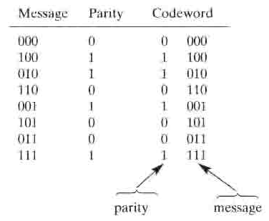
Parity Check codes
Even parity – Summing message bits gives parity bit.
Summing of codeword bits yields a zero ( Even parity)
Linear code : The modulo-2 sum of any two codeword produces another codeword.
Non-linear code: The modulo-2 sum of any two codeword will not produces another codeword.

Slide 4
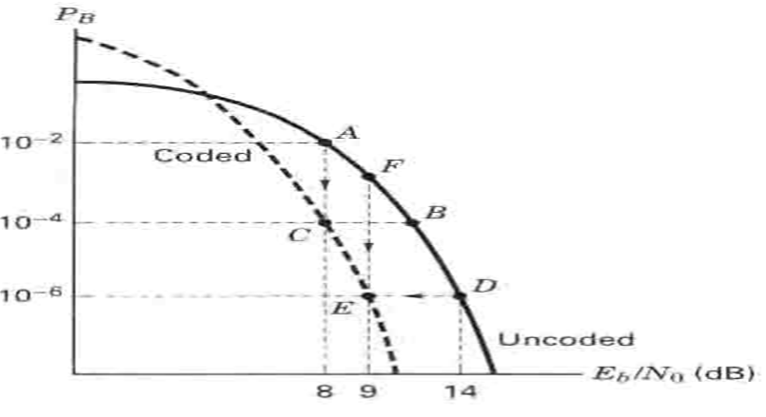

Comparison of coded vs uncoded error performance
Coding Gain
ECC needs redundancy - requires more transmission BW

Slide 5
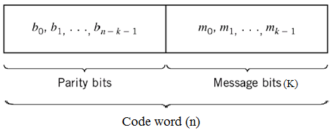
Terminology
Codeword : It contains message bits and redundant bits.
Systematic codes: The message bits and parity bits can be identified in codeword.
Non-systematic codes: The message bits and parity bits can not be identified in codeword.
Coding efficiency / Code rate : ratio of message bits in a block to the transmitted bits for that block.
Notes:
When the signal is transmitted over channel, noise interferes with it. Because of this noise, errors are introduced in the received data.
These errors can be corrected with the help of ECC.
ECC uses channel encoder and decoder.
The channel encoder adds extra bits to the input message.
The decoder identifies the redundant bits and uses them to detect and correct errors in the received message,
Due to additional bits, the overall data rate increases.

Slide 6
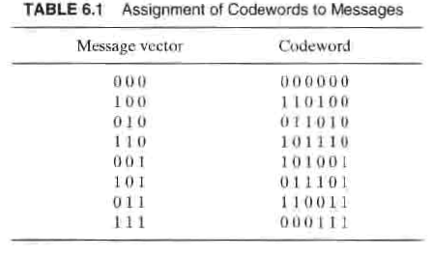
Linear Block Codes – Hamming code
Linear block codes – (n,k)
Linear block codes – (6,3)
Linear block code : Sum of two codeword yields another codeword.
For a (127,92) code – how many codewords required ?
Memory required to store codewords ?

Slide 7



Linear Block Codes – Generator matrix (G)
It is possible to reduce the complexity by generating the required codewords as needed, instead of storing them.
Generator matrix (G) dimension (k x n)
Generator Matrix,
Code word

Slide 8

Generator Matrix,
Code word
Code word for message 110

Slide 9
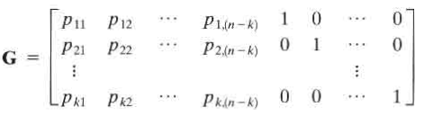



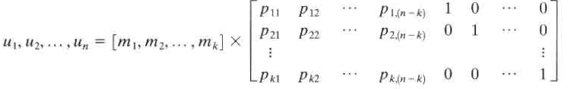

Mapping message to a codeword
A Linear block code will have a generator matrix of the form
Code word

Slide 10
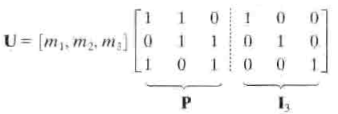



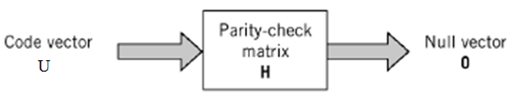

For a (6,3) code ,
Transmitter
Receiver

Slide 11
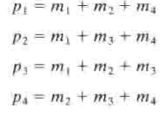


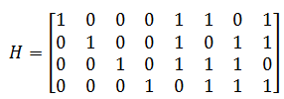
Problem 1
Consider a systematic block code whose parity check equations are
Where mi are message bits and pi are check bits. Find the generator matrix and parity check matrix..

Slide 12



Problem 2
A systematic (6,3) code has the following generator matrix :
Determine generator parity array matrix and parity check matrix?

Slide 13

Problem 3
The generator matrix for a (6,3) block code is given below. Find all codewords of the code.
Solution:
Code word
Possible messages:
Parity bits
Codewords
S.No | m1 | m2 | m3
1 | 0 | 0 | 0
2 | 0 | 0 | 1
3 | 0 | 1 | 0
4 | 0 | 1 | 1
5 | 1 | 0 | 0
6 | 1 | 0 | 1
7 | 1 | 1 | 0
8 | 1 | 1 | 1
p1 | p2 | p3
0 | 0 | 0
1 | 1 | 0
1 | 0 | 1
0 | 1 | 1
0 | 1 | 1
1 | 0 | 1
1 | 1 | 0
0 | 0 | 0
U
000000
001110
010101
011011
100011
101101
110110
111000

Slide 14

Problem 3 ( Alternate method)
The generator matrix for a (6,3) block code is given below. Find all codewords of the code.
Solution:
Code word
Possible messages:
Parity bits
Codewords
S.No | m1 | m2 | m3
1 | 0 | 0 | 0
2 | 0 | 0 | 1
3 | 0 | 1 | 0
4 | 0 | 1 | 1
5 | 1 | 0 | 0
6 | 1 | 0 | 1
7 | 1 | 1 | 0
8 | 1 | 1 | 1
p1=(m2⊕m3) | p2=(m1⊕m3) | p3=(m1⊕m2)
0 | 0 | 0
1 | 1 | 0
1 | 0 | 1
0 | 1 | 1
0 | 1 | 1
1 | 0 | 1
1 | 1 | 0
0 | 0 | 0
U
000000
001110
010101
011011
100011
101101
110110
111000

Slide 15


Problem 4
The generator matrix for a (6,3) block code is given below. Find all codeword of the code.
Solution:
Code word
Possible messages:
Parity bits
Codeword
S.No | m1 | m2 | m3
1 | 0 | 0 | 0
2 | 0 | 0 | 1
3 | 0 | 1 | 0
4 | 0 | 1 | 1
5 | 1 | 0 | 0
6 | 1 | 0 | 1
7 | 1 | 1 | 0
8 | 1 | 1 | 1
p1=(m1⊕m3) | p2=(m1⊕m2) | p3=(m2⊕m3)
0 | 0 | 0
1 | 0 | 1
0 | 1 | 1
1 | 1 | 0
1 | 1 | 0
0 | 1 | 1
1 | 0 | 1
0 | 0 | 0
U
000000
101001
011010
110011
110100
011101
101110
000111

Slide 16

Linear Block Codes – Parity Check matrix (H)
Parity check matrix (H) enable us to decode the received codeword.
Transmitter
Receiver
Rows of G are orthogonal to the rows of H.
To check the received vector is a valid member of a codeset

Slide 17


Syndrome Testing
To check received codeword is valid or not.
If S=0 ( the received without error )
If S≠0 ( the received with error)
The receiver perform ARQ / FEC
FEC – Locate the error and correct them
ARQ – Request for retransmission.
Error detection & correction
Calculate the syndrome ‘S’
Locate the error pattern corresponding to the ‘S’ from the syndrome lookup table
Correct the received codeword by performing modulo-2 addition with error pattern.

Slide 18
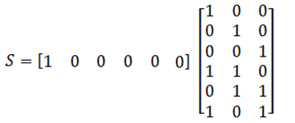


Syndrome Look-Up table (6,3)
1. Calculate the syndrome ‘S’
2. Locate the error pattern corresponding to the ‘S’ from the syndrome lookup table
Syndrome
1 | 0 | 0
Syndrome
S.No | Error Location | Error Pattern
1 | 1st | 1 | 0 | 0 | 0 | 0 | 0
2 | 2nd | 0 | 1 | 0 | 0 | 0 | 0
3 | 3rd | 0 | 0 | 1 | 0 | 0 | 0
4 | 4th | 0 | 0 | 0 | 1 | 0 | 0
5 | 5th | 0 | 0 | 0 | 0 | 1 | 0
6 | 6th | 0 | 0 | 0 | 0 | 0 | 1
Syndrome
1 | 0 | 0
0 | 1 | 0
0 | 0 | 1
0 | 1 | 1
1 | 0 | 1
1 | 1 | 0

Slide 19
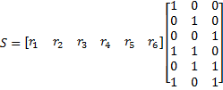
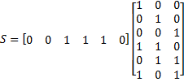
Problem 4 (Contd.)
Assume that the codeword 101110 is transmitted and the vector 001110 is received. Show how a decoder can correct the error.
Solution:
1. Calculate the syndrome ‘S’
r = 001110
2. Locate the error pattern corresponding to the ‘S’ from the syndrome lookup table

Slide 20
Problem 4 (Contd.)
3. Correct the received codeword by performing modulo-2 addition with error pattern.

Slide 21

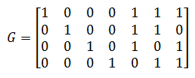
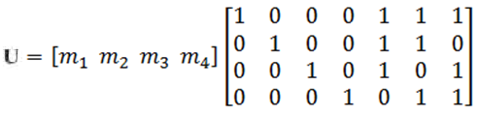
Problem 5
The parity check matrix for a (7,4) linear block code is given by
1. Find the generator matrix 2. List all the code vectors. 3. Compute the syndrome 4. Received codeword is 1011101, find the syndrome and correct the transmitted codeword.
Solution:
1. Find the generator matrix
Code word

Slide 22
2. List all the code vectors
Possible messages:
Parity bits
Codeword
S.No | m1 | m2 | m3 | m4
1 | 0 | 0 | 0 | 0
2 | 0 | 0 | 0 | 1
3 | 0 | 0 | 1 | 0
4 | 0 | 0 | 1 | 1
5 | 0 | 1 | 0 | 0
6 | 0 | 1 | 0 | 1
7 | 0 | 1 | 1 | 0
8 | 0 | 1 | 1 | 1
9 | 1 | 0 | 0 | 0
10 | 1 | 0 | 0 | 1
11 | 1 | 0 | 1 | 0
12 | 1 | 0 | 1 | 1
13 | 1 | 1 | 0 | 0
14 | 1 | 1 | 0 | 1
15 | 1 | 1 | 1 | 0
16 | 1 | 1 | 1 | 1
(m1⊕m2⊕m3) | (m1⊕m2⊕m4) | (m1⊕m3⊕m4)
0 | 0 | 0
0 | 1 | 1
1 | 0 | 1
1 | 1 | 0
1 | 1 | 0
1 | 0 | 1
0 | 1 | 1
0 | 0 | 0
1 | 1 | 1
1 | 0 | 0
0 | 1 | 0
0 | 0 | 1
0 | 0 | 1
0 | 1 | 0
1 | 0 | 0
1 | 1 | 1
Codeword
0000000
0001011
0010101
0011110
0100110
0101101
0110011
0111000
1000111
1001100
1010010
1011001
1100001
1101010
1110100
1111111

Slide 23
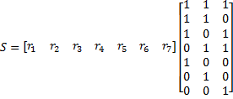
3. Compute the syndrome
S.No | Error Location | Error Pattern
1 | 1st | 1 | 0 | 0 | 0 | 0 | 0 | 0
2 | 2nd | 0 | 1 | 0 | 0 | 0 | 0 | 0
3 | 3rd | 0 | 0 | 1 | 0 | 0 | 0 | 0
4 | 4th | 0 | 0 | 0 | 1 | 0 | 0 | 0
5 | 5th | 0 | 0 | 0 | 0 | 1 | 0 | 0
6 | 6th | 0 | 0 | 0 | 0 | 0 | 1 | 0
7 | 7th | 0 | 0 | 0 | 0 | 0 | 0 | 1
Syndrome
1 | 1 | 1
1 | 1 | 0
1 | 0 | 1
0 | 1 | 1
1 | 0 | 0
0 | 1 | 0
0 | 0 | 1
Syndrome
Syndrome
1 | 1 | 1

Slide 24
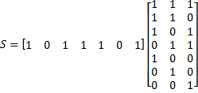
4. Received codeword is 1011101 , find the syndrome and correct the transmitted codeword.
1. Calculate the syndrome ‘S’
2. Locate the error pattern
3. Correct the received codeword by performing modulo-2 addition with error pattern.

Slide 25
Metrics – Hamming Code
Weight of a codeword U is the number of nonzero elements in U
Hamming distance between two codewords U1 and U2 is the number of elements in which they differ.
The minimum distance dmin of a linear block code is equal to the minimum weight of any nonzero codeword in the code.
Correct up to ( dmin − 1) / 2 errors in each codeword.
Code with dmin can detect up to [dmin − 1] errors
S.No | m1 | m2 | m3
1 | 0 | 0 | 0
2 | 0 | 0 | 1
3 | 0 | 1 | 0
4 | 0 | 1 | 1
5 | 1 | 0 | 0
6 | 1 | 0 | 1
7 | 1 | 1 | 0
8 | 1 | 1 | 1
U
000000
101001
011010
110011
110100
011101
101110
000111
Weight
0
3
3
4
3
4
4
3

Slide 26
Unit 2 : Error Control Coding Techniques
Linear block codes – Cyclic codes
Advantage of cyclic code: Easy to encode and possess a well defined mathematical
structure which led to the development of very efficient decoding schemes.

Slide 27
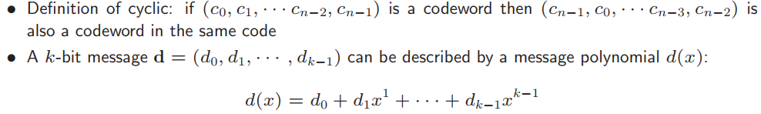

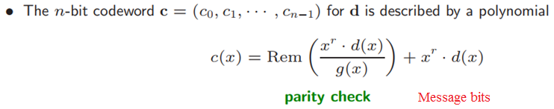
Cyclic code
A cyclic code is a linear code that has the property that a cyclic shift on any of its codewords produces another codeword.
Cyclic shift may be leftwards or rightwards by any number of places.

Slide 28


Encoding Cyclic code
Systematic Code
Given an (n,k) cyclic code with generator polynomial g(x), the message polynomial m(x) is encoded into a systematic codeword using the following steps:
Multiply m(x) by
Divide the result of the first step by g(x) and find the remainder r(x)
Add the remainder r(x) to the result of the first step to give the codeword.
Non- Systematic Code
Given an (n,k) cyclic code with generator polynomial g(x), the message polynomial m(x) is encoded into a non-systematic codeword by,

Slide 29


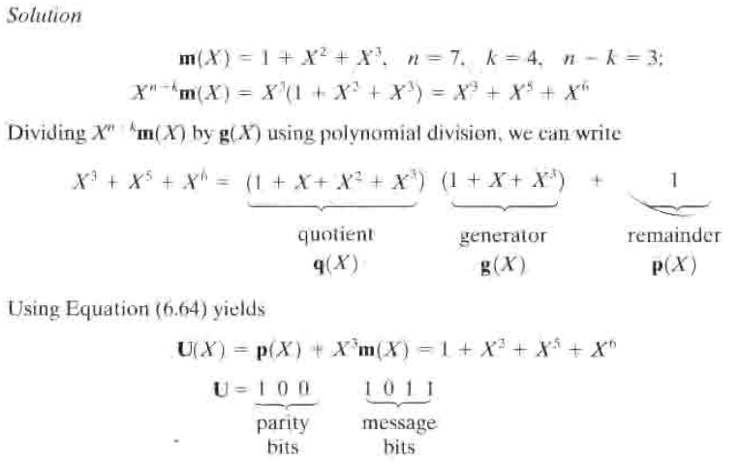
Problem 1
Using generator polynomial , generate a systematic codeword from (7,4) codeword set for the message m=1011.
Solution:
Verification:

Slide 30
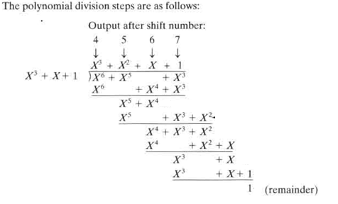

Problem 1 (Polynomial division-Previous problem contd..)

Slide 31

Problem 2
Using generator polynomial , generate a non-systematic codeword from (7,4) codeword set for the message m=1011.
Solution:
C(x)=(1 1 1 1 1 1 1)

Slide 32
Determination of Generator matrix from cyclic polynomial
Generator matrix (G) has the size of (kxn)
Generator polynomial is given by,
Multiply both sides of this polynomial by , where i=0,1,...,(k-1)
The equation gives the polynomial for the rows of a generating polynomials.
Q = n - k

Slide 33
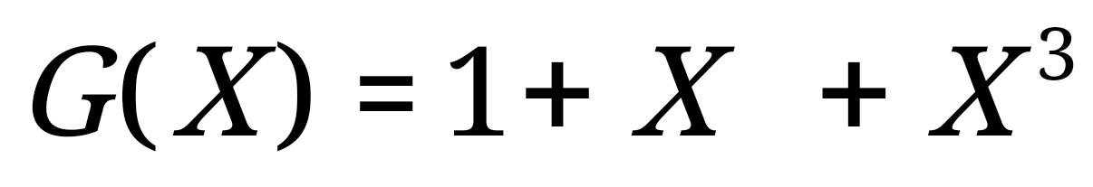
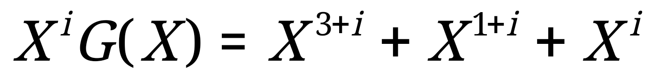
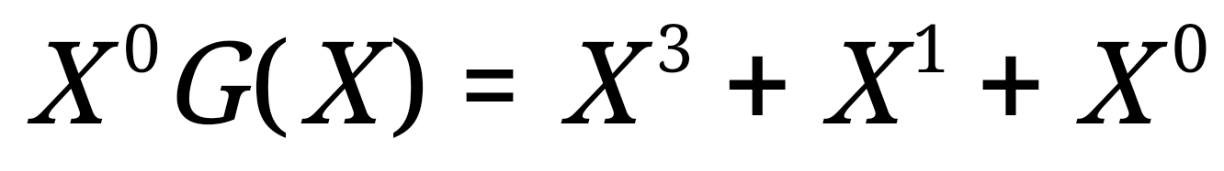
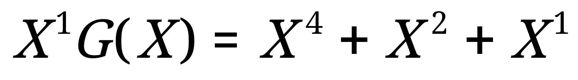
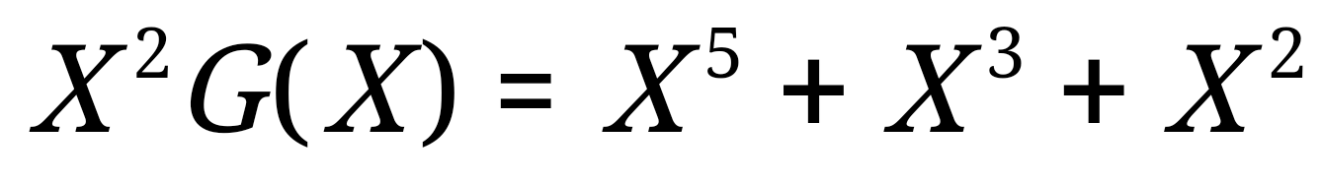
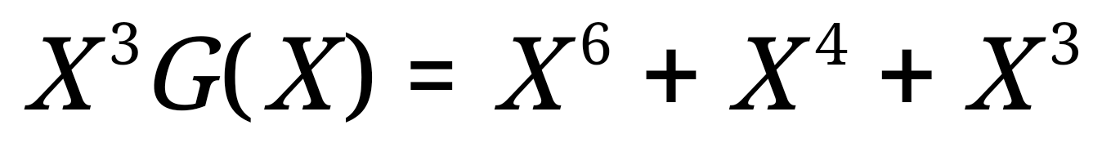
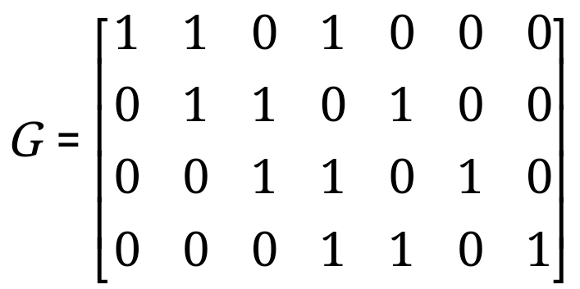
Problem 3A
Obtain the generator matrix corresponding to for a (7,4) cyclic code.
Solution
The row of a generator matrix are given by
Where i = 0,1,...,(k-1)
For Row 1 : i=0;
For Row 2 : i=1;
For Row 3 : i=2;
For Row 4 : i=3;

Slide 34
Problem 3B
Obtain the generator matrix corresponding to for a (7,4) cyclic code.
Solution
Where t=k,k-1,....1
For Row 1 : t=4;
For Row 2 : t=3;
For Row 3 : i=2;
For Row 4 : i=1;

Slide 35
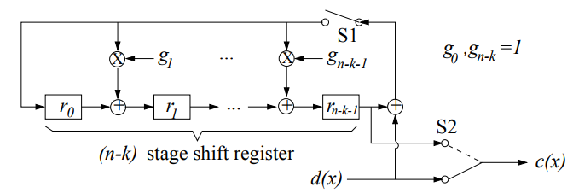
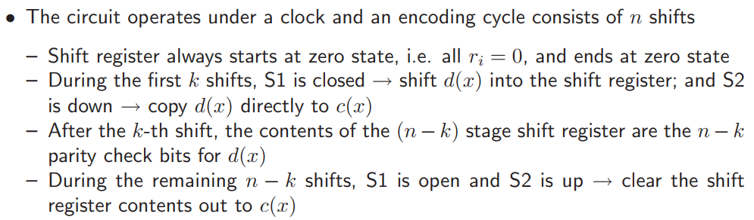
Cyclic Code Encoder

Slide 36
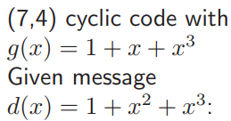
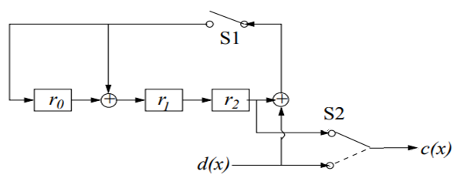
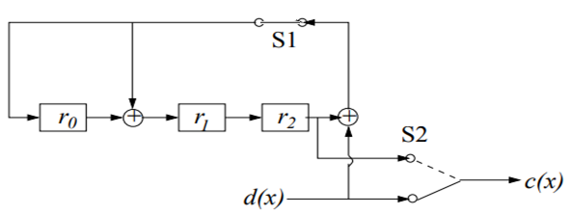
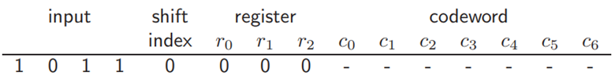
Problem 1
S1 opened up to (n-k) clock cycle
S1 closed up to K clock cycle
S2 upwards upto (n-k) clock cycle
S2 downwards upto K clock cycle
Transmitting first message bit
Transmitting second message bit
Transmitting third message bit
Transmitting forth message bit
Transmitting Parity bit
Transmitting Parity bit
Transmitting Parity bit
The Codeword for the message bit 1011 is 1001011

Slide 37
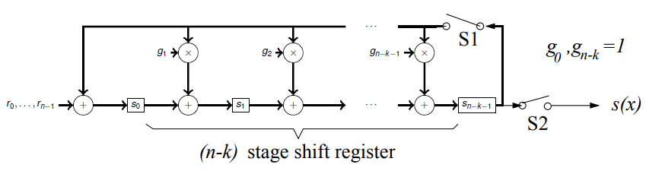
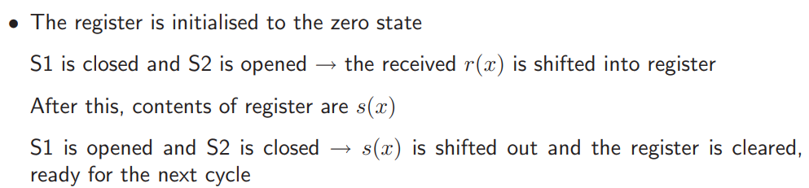
Cyclic code Syndrome Calculation
Errors are detected when the received vector is not a codeword.
For Linear block codes,
For cyclic codes S=r mod G

Slide 38
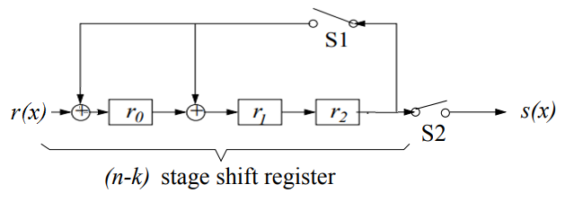

Cyclic code Syndrome Calculation
The received Codeword for the message bit 1011 is 1001011
S1 closed & S2 opened for ‘n’ clock
S1 closed & S2 opened for ‘n’ clock
S1 closed & S2 opened for ‘n’ clock
S1 closed & S2 opened for ‘n’ clock
S1 closed & S2 opened for ‘n’ clock
S1 closed & S2 opened for ‘n’ clock
S1 closed & S2 opened for ‘n’ clock
S1 closed & S2 opened for ‘n’ clock
S1 opened & S2 closed for (n-k) clock
S1 opened & S2 closed for (n-k) clock
S1 opened & S2 closed for (n-k) clock

Slide 39
Syndrome Calculation
Find the syndrome pattern table for the given generator polynomial g(x)
S.No | Error Location | Error Pattern
1 | 1st | 1 | 0 | 0 | 0 | 0 | 0 | 0
2 | 2nd | 0 | 1 | 0 | 0 | 0 | 0 | 0
3 | 3rd | 0 | 0 | 1 | 0 | 0 | 0 | 0
4 | 4th | 0 | 0 | 0 | 1 | 0 | 0 | 0
5 | 5th | 0 | 0 | 0 | 0 | 1 | 0 | 0
6 | 6th | 0 | 0 | 0 | 0 | 0 | 1 | 0
7 | 7th | 0 | 0 | 0 | 0 | 0 | 0 | 1
Syndrome
1 | 0 | 0
0 | 1 | 0
0 | 0 | 1
1 | 1 | 0
0 | 1 | 1
1 | 1 | 1
1 | 0 | 1

Slide 40
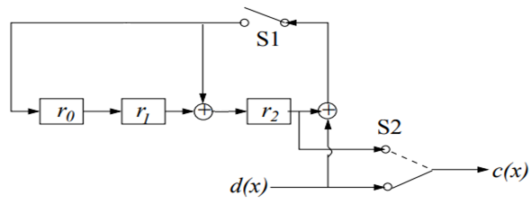
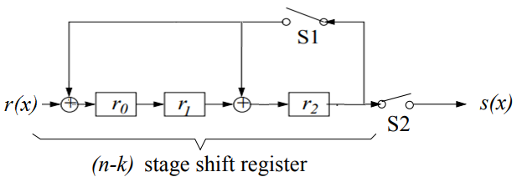
Problem 2
Sketch the encoder and syndrome for the generator polynomial
and obtain the syndrome for the received codeword 1001011.
Encoder
Syndrome

Slide 41
Unit 2 : Error Control Coding Techniques
Convolutional codes

Slide 42
Block codes : In this coding scheme, each k-bit information block is converted to an n-bit block with (n-k) redundant bits added to k-bit symbols. These redundant bits are termed as parity bits that carry no information.
Convolutional codes : In this coding scheme, encoder takes one message bit at a time and generates two or more encoded bits. Encoder has a memory order of ‘m’. As it contains memory, it is implemented with sequential logic circuits.
In the block codes, the information bits are followed by the parity bits.
In convolutional codes the information bits are spread along the sequence.
Block codes encode one block at a time, independent of all other blocks that will be encoded.
Convolutions codes encode much longer inputs at once, and hope to take advantage of this by spreading error correcting information over a long area.

Slide 43
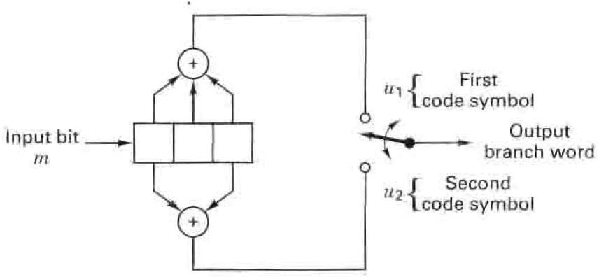
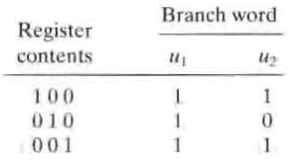




1. Convolution Encoder
Initialize the memory before encoding the first bit (all-zero)
Clear out the memory after encoding the last bit (all-zero), a tail of zero-bits is appended to data bits.
Dimension of the code: Encoder takes one message(k) bit at a time and generates two coded(n) bits.
Constraint length(K) : Number of shifts over which a single message bit can influence the encoder output.
k = 1 bit , n = 2 bits , Rate = k/n = ½ K = 3
k = 2 bits , n = 4 bits , Rate = k/n = ½ K = 3

Slide 44

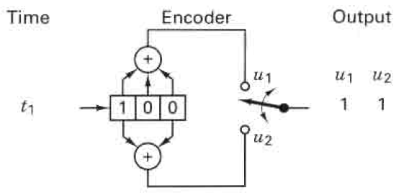
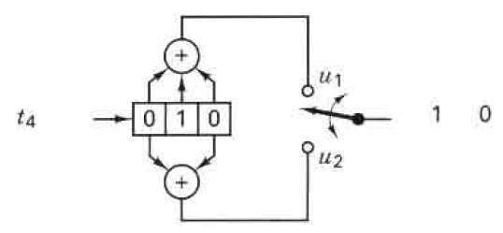
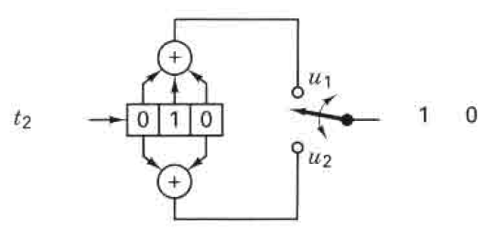
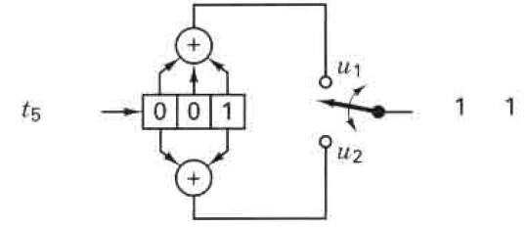
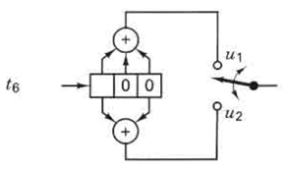


Slide 45





2. Polynomial Representation

Slide 46
3. State Diagram
A state diagram is a way to represent the encoder.
A state diagram contains all the states and all possible transitions between them
In a Convolutional encoder, the state is represented by the content of the memory.
Hence, there are states, K is the constraint length.
A current input to the machine, can predict the output of the machine.
Only two transitions initiate from a state.
Only two transitions end up in a state

Slide 47
3. State Diagram
Input
0/00
Output
(Branch word)
Current State | Input m | Next State | Output U1 U2
S₀ 00
S₁ 01
S₂ 10
S₃ 11
Current State | Input m | Next State | Output U1 U2
S₀ 00 | 0 | S₀ | 00
 | 1 | S₂ | 11
S₁ 01 | 0 | S₀ | 11
 | 1 | S₂ | 00
S₂ 10 | 0 | S₁ | 10
 | 1 | S₃ | 01
S₃ 11 | 0 | S₁ | 01
 | 1 | S₃ | 10
Current State | Input m | Next State | Output U1 U2
S₀ 00 | 0 | S₀ | 00
 | 1 | S₂ | 11
S₁ 01
S₂ 10
S₃ 11
00
1/11
0/11
1/00
10
01
0/10
1/01
11
0/01
1/10

Slide 48
4. Trellis Diagram
Trellis diagram is an extension of the state diagram that shows the passage of time.
Current State | Input m | Next State | Output U1 U2
S₀ 00 | 0 | S₀ | 00
 | 1 | S₂ | 11
S₁ 01 | 0 | S₀ | 11
 | 1 | S₂ | 00
S₂ 10 | 0 | S₁ | 10
 | 1 | S₃ | 01
S₃ 11 | 0 | S₁ | 01
 | 1 | S₃ | 10
0/00
State
1/11
0/11
1/00
0/10
1/01
0/01
1/10
Time

Slide 49
4. Trellis Diagram
State
State
0/00
0/00
0/00
0/00
1/11
1/11
1/11
1/11
0/11
0/11
1/00
1/00
0/10
0/10
0/10
1/01
1/01
1/01
0/01
0/01
1/10
1/10
msg
Time
codeword

Slide 50
5. Code Tree
At each successive input bit time, the encoding process can be described by traversing the diagram from left to right, each tree branch describes an output branch word.
If input bit is a zero – move the next rightmost branch in the upward direction.
If input bit is a one – move the next rightmost branch in the downward direction.
0
1

Slide 51

S₀
S₀
00
00
11
S₀
S₂
S₁
11
Current State | Input m | Next State | Output U1 U2
S₀ 00 | 0 | S₀ | 00
 | 1 | S₂ | 11
S₁ 01 | 0 | S₀ | 11
 | 1 | S₂ | 00
S₂ 10 | 0 | S₁ | 10
 | 1 | S₃ | 01
S₃ 11 | 0 | S₁ | 01
 | 1 | S₃ | 10
10
0
S₂
00
01
S₀
S₃
S₀
1
11
11
S₁
00
10
S₂
S₂
S₁
01
01
S₃
10
S₃

Slide 52

Problem 1
Draw the Convolution encoder, state diagram, tree diagram and trellis diagram for the K=3, rate=1/3 code generated by
Obtain the codeword for the message : 1 1 1 0

Slide 53



1. Convolution Encoder
4. Codeword for the
message : 1 1 1 0
011 100 001 010
101 000
2. State Diagram
3. Trellis Diagram

Slide 54

Problem 2
Draw the state diagram, tree diagram and trellis diagram for the K=3, rate=1/3 code generated by

Slide 55
Unit 2 : Error Control Coding Techniques
Viterbi Decoding

Slide 56

Viterbi Algorithm
Viterbi algorithm is also called as Maximum Likelihood Decoding
Convolution decoding - It is used to correct error.
Viterbi algorithm fully based on Trellis structure.
The decoding algorithm uses two metrics: the branch metric (BM) and the state metric (SM).
BM : Measure of “distance” between what was transmitted and what was received. (Hamming distance)
SM: The path metric is a value associated with a state in the trellis [it corresponds to the Hamming distance over the most likely path from the initial state to the current state in the trellis].
Survivor or active path : The path which is having lower SM value is retained and other path is discard.

Slide 57
Viterbi decoding – Algorithm steps
Step 1 : Find the state metric and branch metric value for each state. In initial node, state metric value is set to zero.
Step 2: If the state receives more than one branch path, then minimum state metric path is retained and others are discard.
Step 3: Repeat step 1 and step 2 until received bit sequence stop.
Step 4: Finally find the active path. The active path codeword is the corrected codeword and find the original sequence.

Slide 58

Viterbi decoding
Z
=
(
11
00
00
10
11
)
0/00
0/00
0/00
0/00
0/00
1/11
1/11
1/11
1/11
1/11
0/11
0/11
0/11
0/10
1/00
1/00
1/00
0/10
0/10
0/10
1/01
1/01
1/01
1/01
0/01
0/01
0/01
1/10
1/10
1/10
11
00
00
10
11

Slide 59
Viterbi decoding
Label all branches with the branch metric (Hamming distance)
i =1
0
2
0
0
1
2
00
0
2
2
1
0
10
2
1
0
0
1
2
1
1
0
1
01
1
1
1
2
2
1
1
11
1
0
1

Slide 60
Viterbi decoding
Branch metric
State metric
i =2
0
2
2
0
0
1
2
00
0
2
2
1
0
0
10
2
1
0
0
1
2
1
1
0
1
01
1
1
1
2
2
1
1
11
1
0
1

Slide 61
Viterbi decoding
Branch metric
State metric
i =3
0
2
2
2
0
0
1
2
00
0
2
2
1
0
0
4
10
2
1
0
0
1
2
1
1
1
0
1
01
1
1
1
1
2
2
1
1
11
1
0
1

Slide 62
Viterbi decoding
i =3
0
2
2
2
0
0
1
2
00
0
2
2
1
0
0
4
10
2
1
0
0
1
2
1
1
1
0
1
01
1
1
1
1
2
2
1
1
11
1
0
1

Slide 63
Viterbi decoding
i =4
0
2
2
2
2
0
0
1
2
00
0
2
2
X
1
0
0
4
X
1
10
2
1
0
0
1
2
1
1
1
2
X
0
1
01
1
1
X
1
1
2
2
2
1
1
11
1
0
1

Slide 64
Viterbi decoding
i =5
0
2
2
2
3
2
0
0
1
2
00
0
2
2
X
1
0
0
4
X
1
3
10
2
1
0
0
1
2
1
1
1
2
X
0
1
1
01
1
X
1
X
2
1
1
2
2
X
1
2
1
11
1
0
1

Slide 65
Viterbi decoding
i =6
0
2
2
2
3
1
2
0
0
1
2
X
00
0
2
2
X
1
0
0
4
X
1
3
3
10
2
1
0
0
1
2
1
1
1
2
X
X
0
1
1
3
01
1
X
1
X
2
1
1
2
X
1
2
2
1
X
11
1
3
0
1

Slide 66
Viterbi decoding
Received Codeword:
Z
=
(
11
00
00
10
11
)
i =6
0
2
2
2
3
1
2
0
0
1
2
X
00
0
2
2
X
1
0
0
4
X
1
3
3
10
2
1
0
0
1
2
1
1
1
2
X
X
0
1
1
3
01
1
X
1
X
2
1
1
2
X
1
2
2
1
X
11
1
3
0
1

Slide 67
Problem 1
Received Codeword:
Find the correct codeword.
Z
=
(
11
00
00
11
11
)
Label all branches with the branch metric (Hamming distance)
i =1
0
2
2
0
2
0
2
2
3
2
2
00
X
X
X
0
0
2
2
0
0
4
X
1
2
3
10
2
1
X
0
X
0
1
2
1
1
1
2
2
3
X
1
1
01
1
X
1
1
X
1
1
1
1
2
2
1
11
1
X
3
1
1

Slide 68
Reference
B. Sklar, ―Digital Communication Fundamentals and Applications‖, 2nd edition, Pearson Education, 2009

